Slide 1
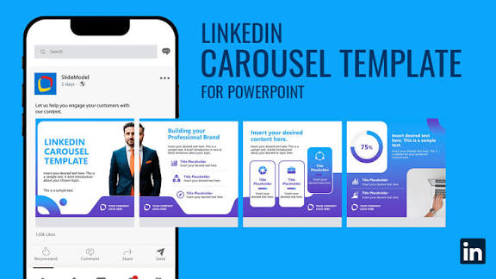
Sample Design:
No Company Logo,
No Mentor’s Name

Slide 2
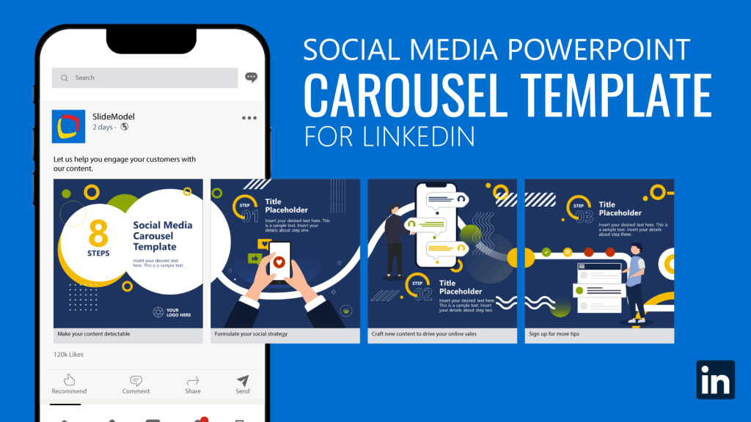
Sample Design:
No Company Logo,
No Mentor’s Name

Slide 3
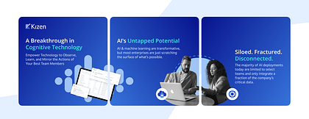
Sample Design:
No Company Logo,
No Mentor’s Name

Slide 4
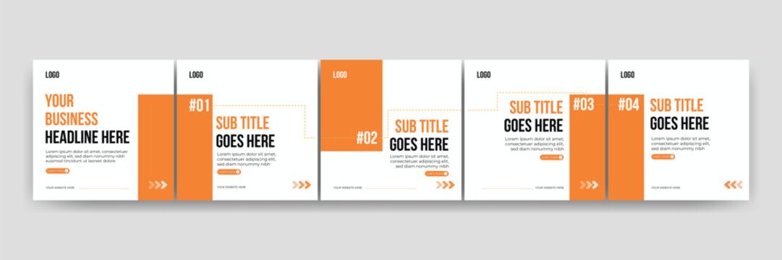
Sample Design:
No Company Logo,
No Mentor’s Name

Slide 5
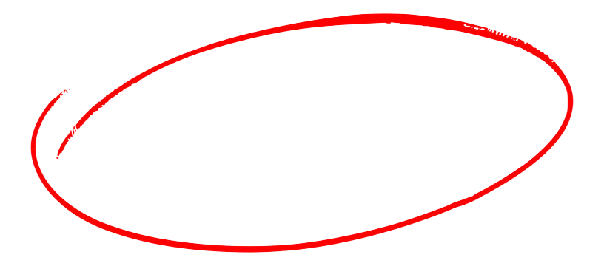
6 key Delta Lake optimization techniques in Databricks that can cut your query times from hours to minutes.
Scroll right ====→

Slide 6
𝗭-𝗢𝗿𝗱𝗲𝗿𝗶𝗻𝗴: is a technique to colocate related information in the same set of files.
𝗖𝗼𝗺𝗽𝗮𝗰𝘁𝗶𝗼𝗻: Combines small files into larger ones to reduce metadata overhead and improve I/O.
𝗣𝗮𝗿𝘁𝗶𝘁𝗶𝗼𝗻𝗶𝗻𝗴: Physically organizes data into separate folders based on column values.
Scroll right ====→

Slide 7
𝗔𝘂𝘁𝗼 𝗖𝗼𝗺𝗽𝗮𝗰𝘁𝗶𝗼𝗻: occurs after a write to a table has succeeded to check if files can further be compacted; if yes, it runs an OPTIMIZE job without Z-Ordering toward a file size of 128 MB.
𝗟𝗶𝗾𝘂𝗶𝗱 𝗖𝗹𝘂𝘀𝘁𝗲𝗿𝗶𝗻𝗴: Dynamically reorganizes data based on query patterns, adapting to your workload without manual tuning.
𝗩𝗮𝗰𝘂𝘂𝗺: Removes old file versions to reclaim storage space.
Scroll right ====→

Slide 8

Start building your future in
Data Engineering
Save this. Share it.
Follow for Data Engineering Interview Tips

